Slide 1
Cognitive correlates of First-Person Shooter gaming: A cross-sectional study of Counter-Strike players
Eleanor R. A. Hyde, Robert Schmidt, Daniel J. Carroll and Claudia C. von Bastian
31/10/2024
ERC 2024

Slide 2






Cognition: mental processes
Cognitive Correlates
Cognitive Plasticity

Slide 3

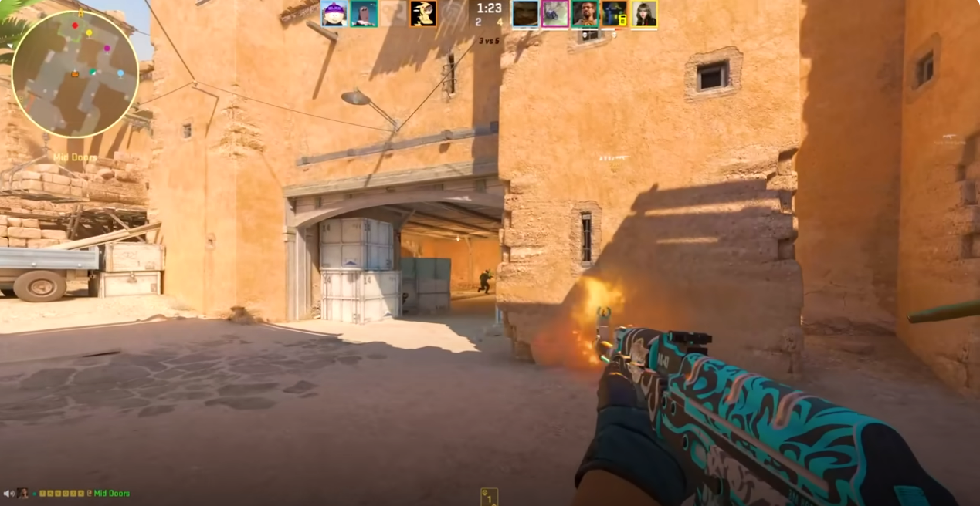


Cognitively challenging leisure activities
Cognitive plasticity can be enhanced through engagement in cognitively challenging leisure activities (von Bastian, Hyde & Jiang, 2023)

Slide 4



Previous Methodological Limitations
Research shows mixed findings for the cognitive correlates of FPS gameplay:
Broad definitions of video games
Small samples of novice players
Limited assessment of video game skill

Slide 5


Cognitive Task
Choice Reaction Time Task
Blue or Green
Curvy or Spiky

Slide 6
Reaction Times (RTs)
Single Speed: general ability to process information
Mixing Speed: ability to conduct two or more tasks in close succession
Switching Speed: ability to switch from one task to another

Slide 7

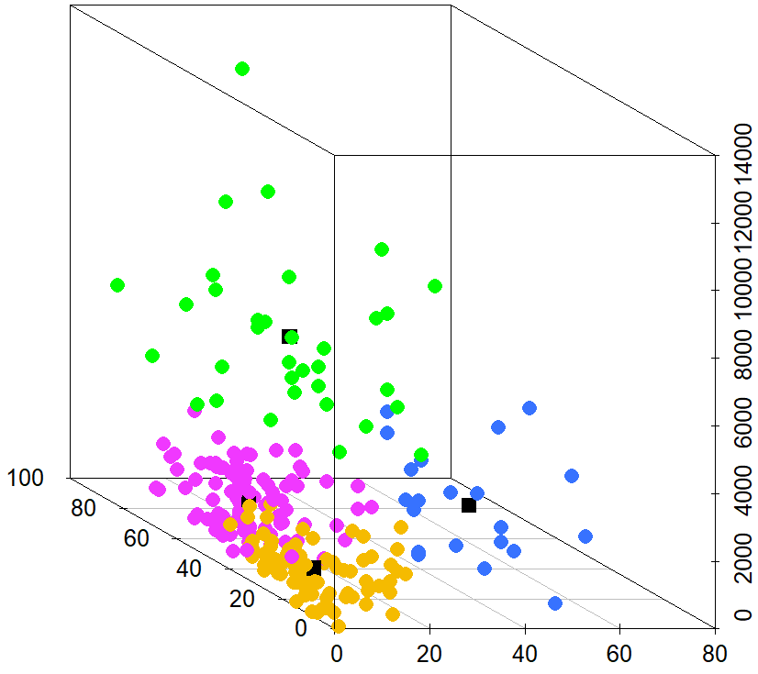
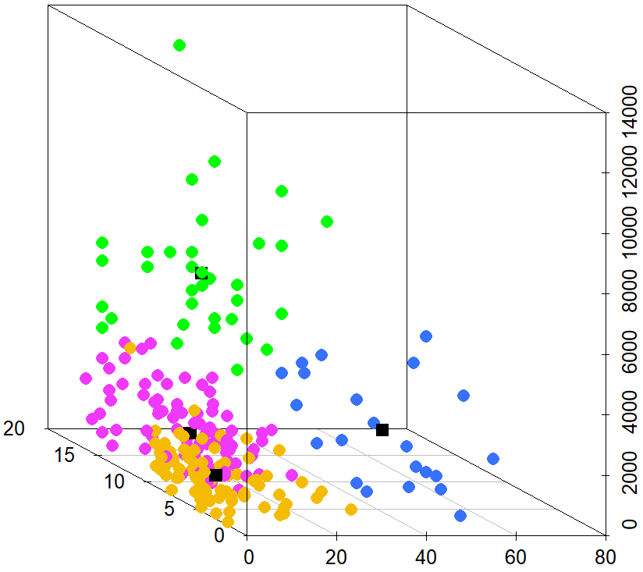
Counter-Strike Skill
Four measures K-means cluster analysis
Semi/Professional (n = 34)
Aspiring (n = 22)
Experienced (n = 101)
Novice (n = 78)
N = 235
Total Hours
Total Hours
Self-Rated Skill
Current Ranking
Weekly Hours
Weekly Hours

Slide 8
Processing Speed
Evidence of an effect of expertise group on single and switching speed
M = 591, SD = 112

Slide 9

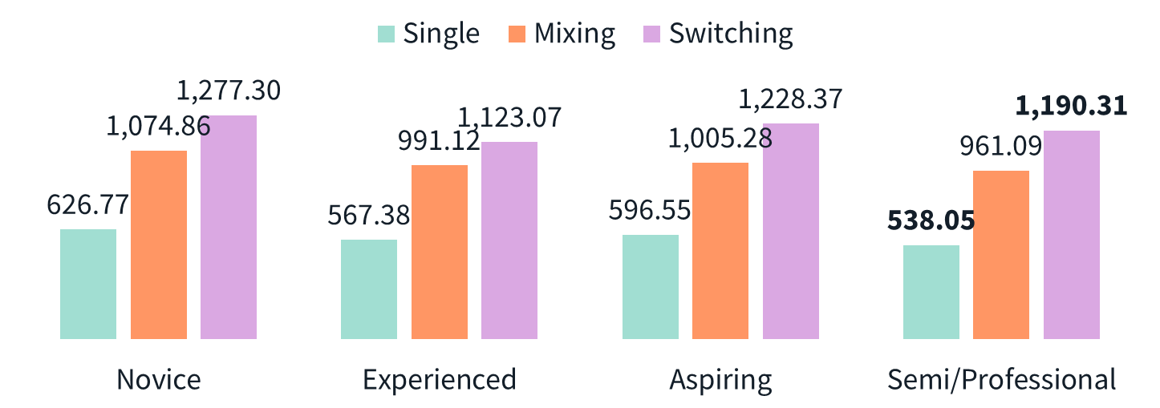
The Drift-Diffusion Model
1. Drift Rate (v) information accumulation
2. Boundary Separation (a) response caution
3. Non-decision time (t0) other non-decisional processes
Drift Rate (v)
Boundary Separation (a)
Green
Blue
Encoding
Decision Time
Response Execution
Non-decision time (t0)

Slide 10

The Drift-Diffusion Model
Evidence of an effect of expertise group on switching drift rate, single boundary separation and single non-decision time
M = 591, SD = 112

Slide 11
Summary
RTs: Semi/Professional players demonstrated faster single trial processing speed, but Experienced players showed faster switching trial speed processing speed
DDM: Semi/Professional players showed faster non-decision times in single trials, higher drift rates in switching trials, but greater boundary separations in single trials

Slide 12
Take-home message
Cognitive correlate: between FPS skill and faster processing speed
Performance advantages go beyond simple RT benefits – utilisation of decisional strategies
Cognitive plasticity: there may be an association between FPS play and greater efficiency in decision making ability (von Bastian et al., 2022)

Slide 13



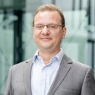


Thanks for listening!
erahyde1@sheffield.ac.uk
www.eleanorhyde.com
Dr Claudia von Bastian
The University of Sheffield
Dr Robert Schmidt
Ruhr-Universität Bochum
Dr Dan Carroll
The University of Sheffield
Endpoint

